Slide 1
Lending Club Case Study
Priya Srivastava

Slide 2
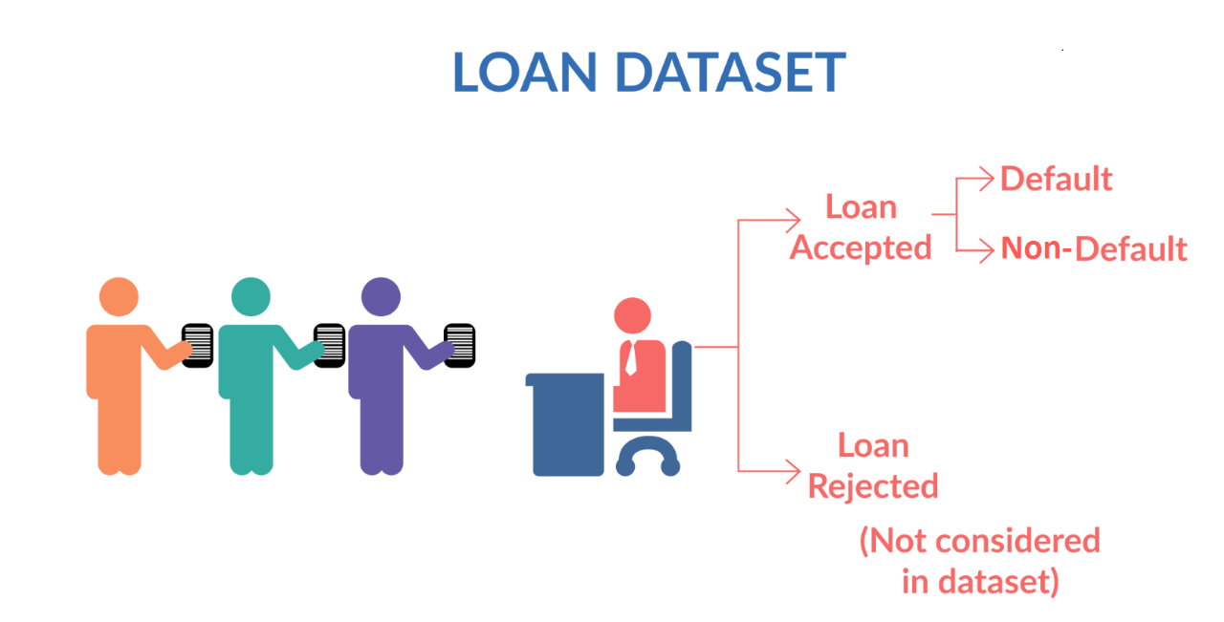
Problem statement
Lending Club is the largest online loan marketplace, facilitating personal loans, business loans, and financing of medical procedures. Borrowers can easily access lower interest rate loans through a fast online interface.
Company has provided complete loan data for all loans issued through the time period 2007 t0 2011
This loan data consist loans with status 'charged-off' which are the 'defaulters‘
Lending Club wants to understand the driving factors (or driver variables) behind loan default, i.e. the variables which are strong indicators of default. The company will utilize this knowledge for its portfolio and risk assessment.

Slide 3
Approach of case study
Data Understanding
Working with data dictionary to understand all relevant column details.
Data Cleaning
Delete non-unique and null column
Data Analysis
Univariate analysis eg. Loan distribution yearwise
Format columns for analysis
Impute null values
Outlier detection and treatment
Bivariate/Multivariate analysis: Identify relation between tw or more columns and how they are impacting loans eg. Loan status and interest rate.
Once Explotary Data analysis done, we will come to conclusion that what are different factors which is causing charged-off loans. Accordingly recommendation will be given to Lending club.

Slide 4
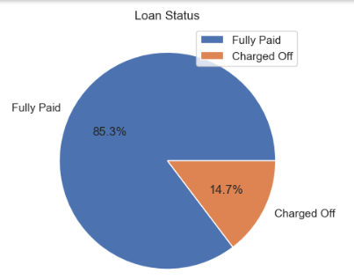
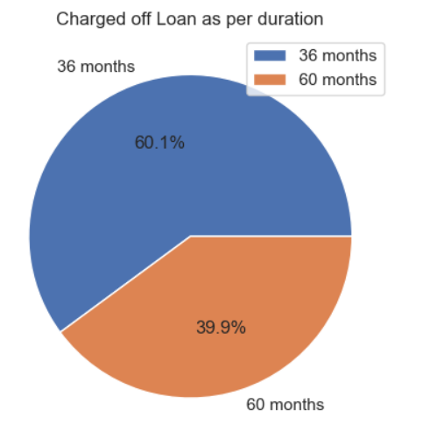
Loan Status
Out of 33814 loan 14.7% Loan has “charged off”.
Almost 60% of charged off loan has sanctioned for 36months.

Slide 5
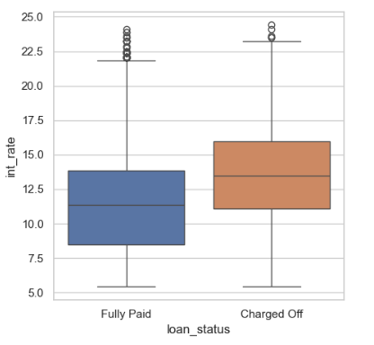
Loan Status vs Interest Rate
In general interest rates are high for default loans

Slide 6
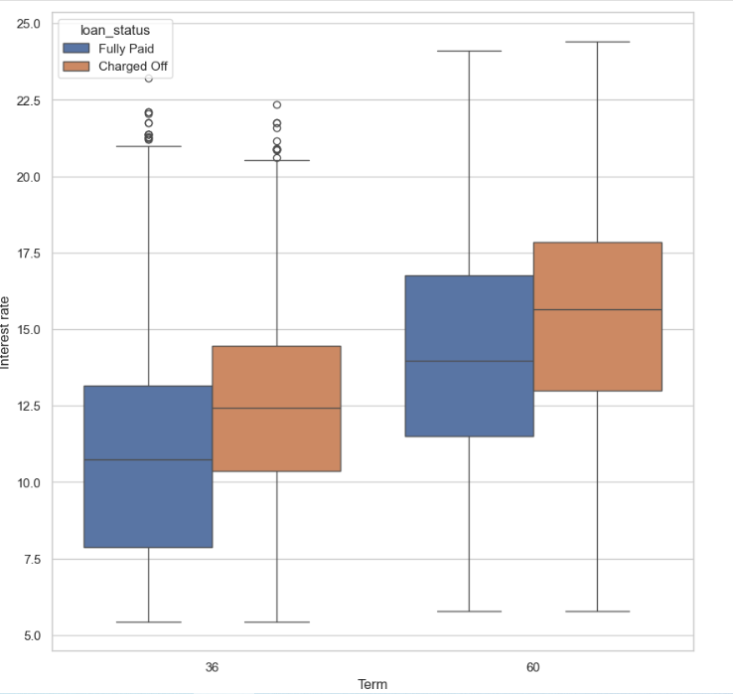
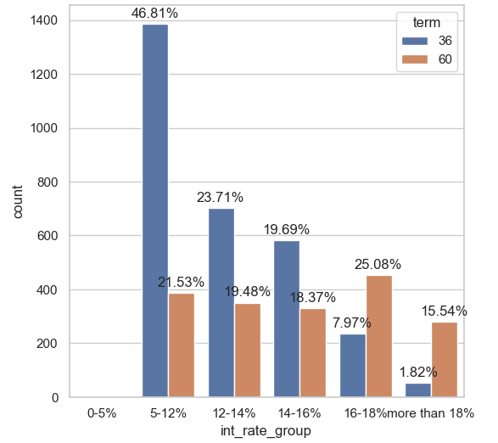
Interest Rate and Term
Though most charged off loan are sanctioned for 36months, The one which is issued for 60months with high interest rate is prone to default.

Slide 7
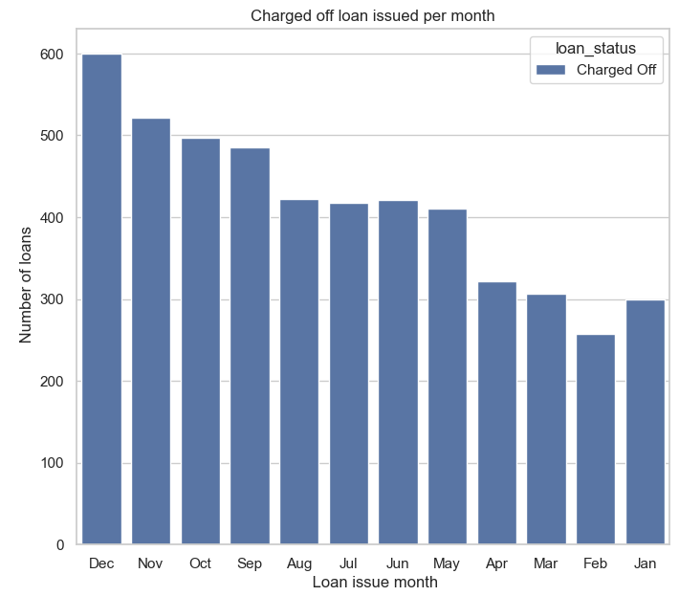
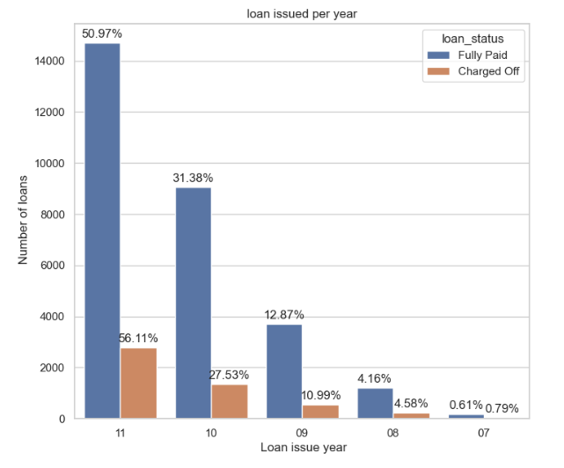
Charged off loan Year and Monthwise
If we see the trend there is drastic change in loan issued per year.
Most loans issued on Dec-2011 has charged off
Last quarter max loans are sanctioned.

Slide 8
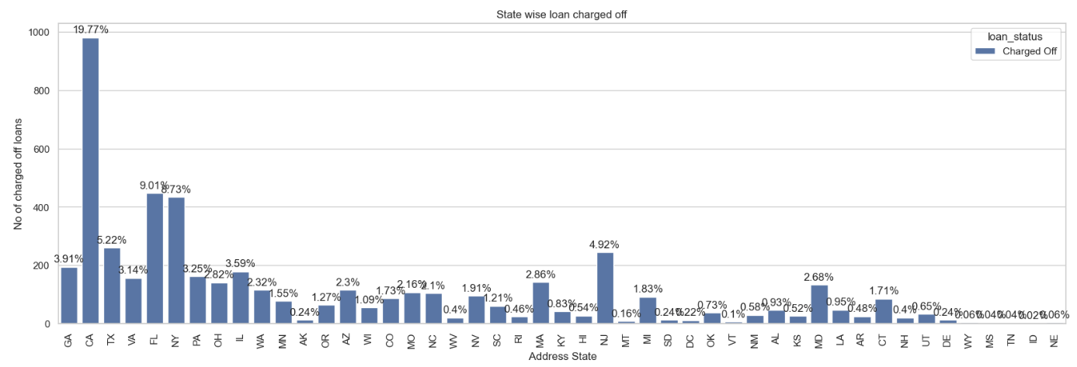
Address state wise loan charged off
CA,FL,NY state has good percentage of loan charged off

Slide 9
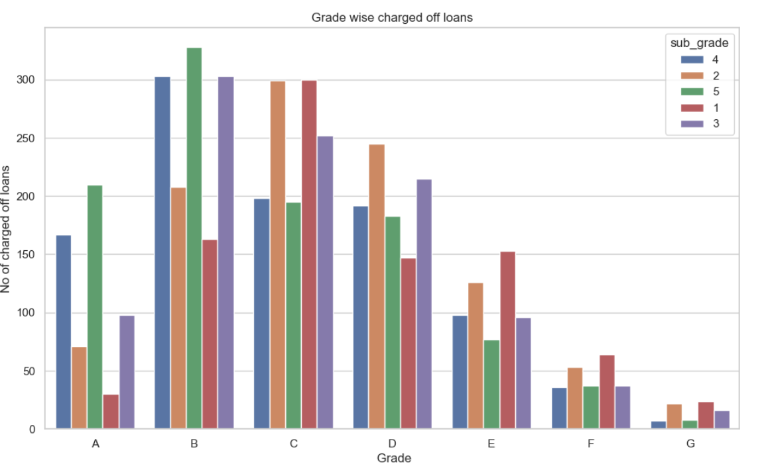
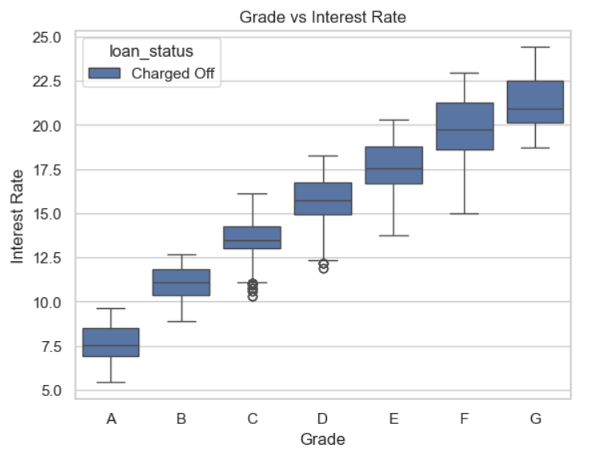
Interest Rate and Grade
Charged off loans for Grade B seems pretty high even though interest rate is between 10-12.5%
Grade G with is with higher interest rate and are likely to default.

Slide 10
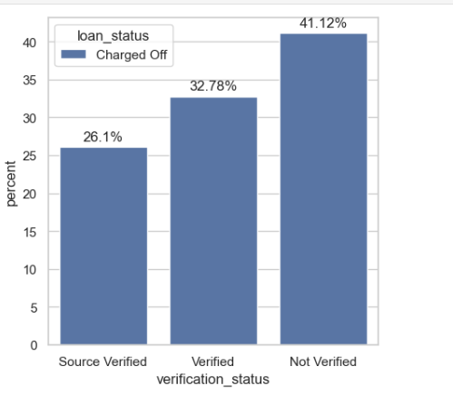
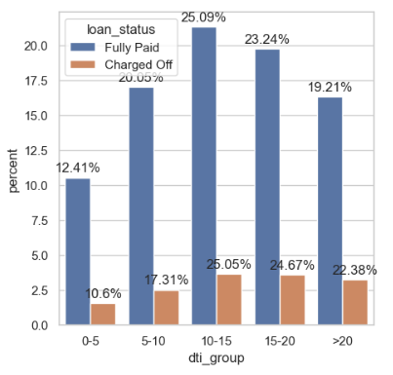
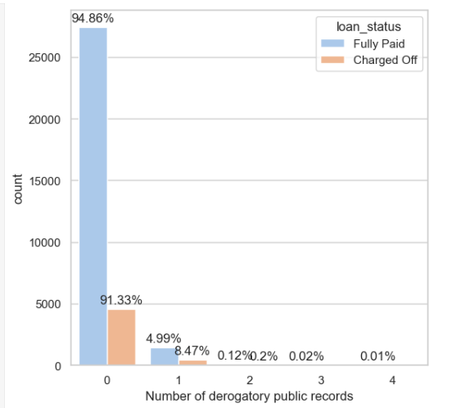
Debt to income and Verification Status
Large no of applicants have DTI.
Most of the applicants have no derogatory public records.
Not verified loan is mostly going to charged off

Slide 11
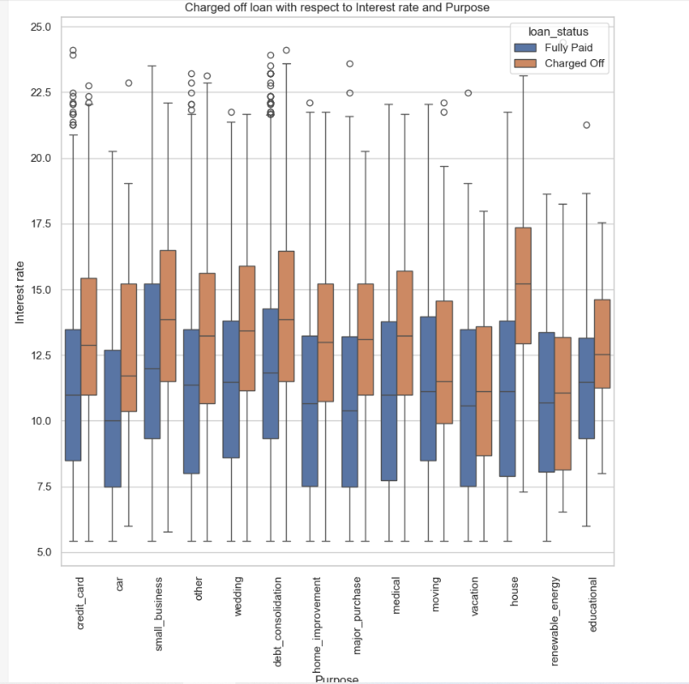
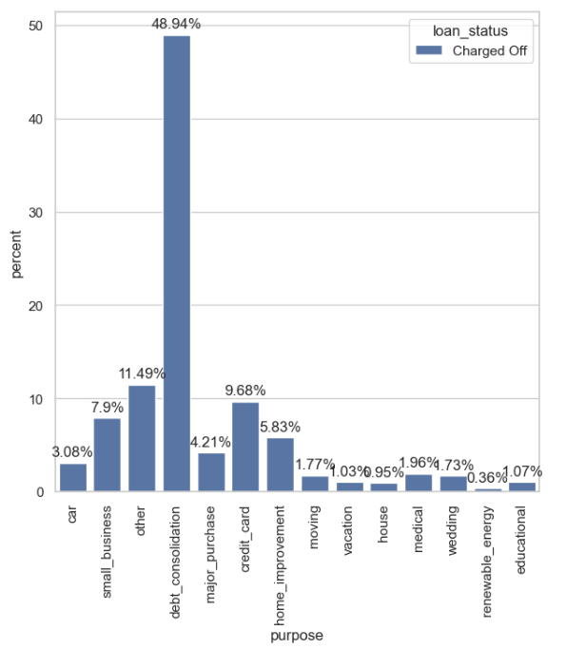
Purpose and Interest Rate
For Debt Consolidation maximum charged off has happened.
Higher the interest rate difficult to pay.

Slide 12
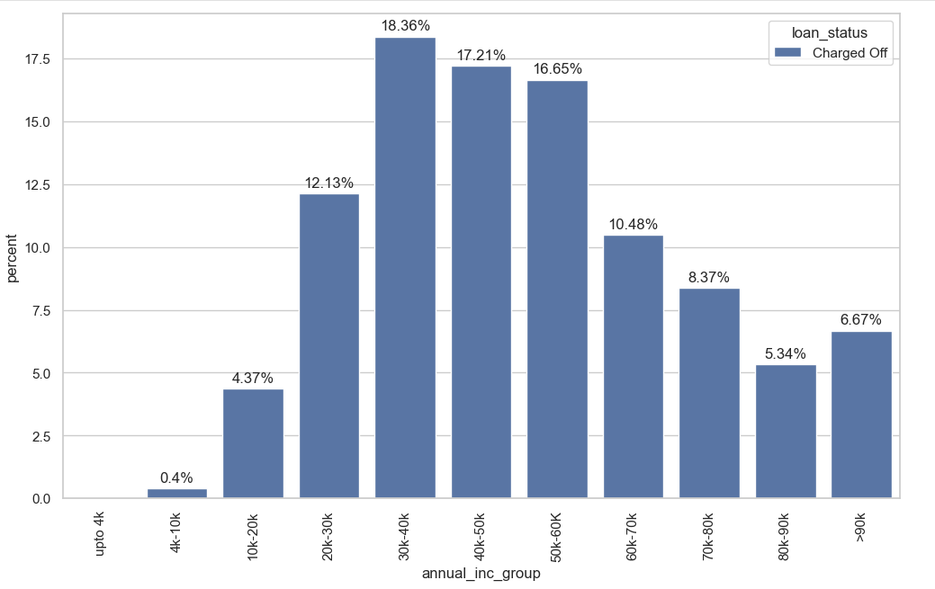
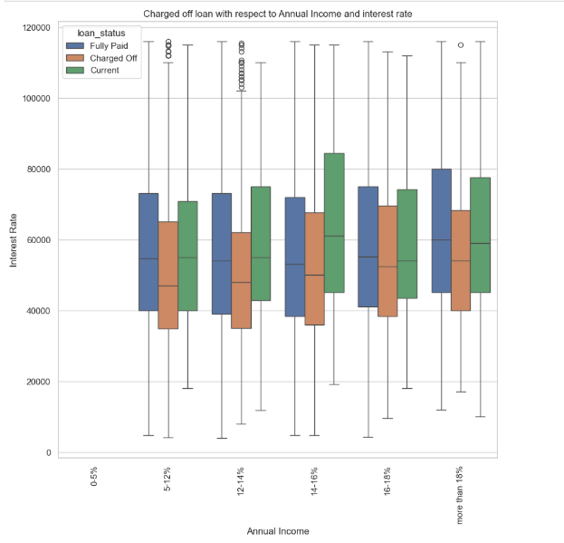
Interest rate, Annual Income
Members having income 20-60k are charged off more ~50% irrespective of interest rate.

Slide 13
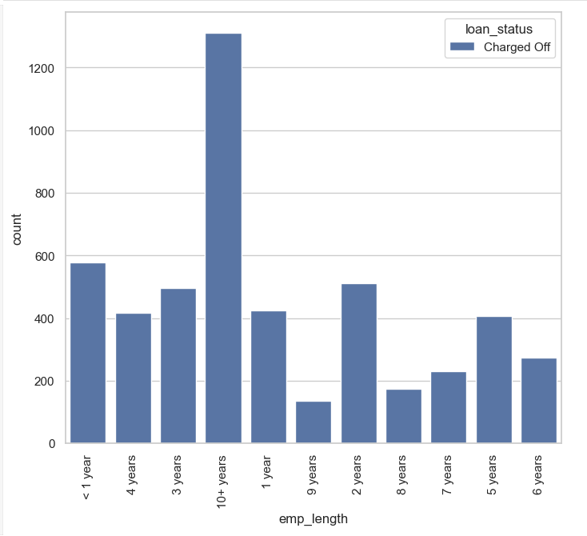
Employeement length
Employee having greater experience is more likely to default.

Slide 14
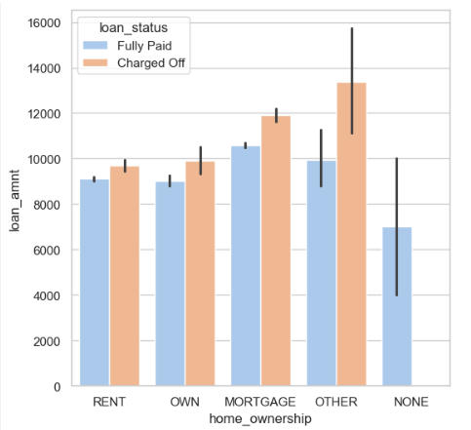
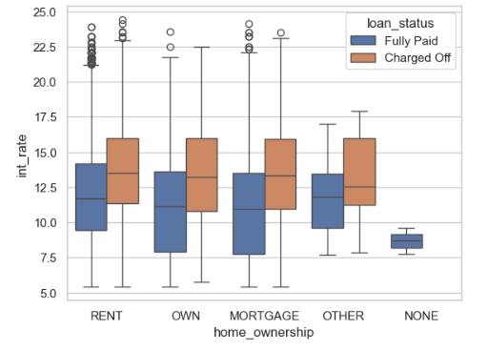
Home Ownership
Home ownership ”Others” most default in general.
Home ownership is not related to interest rate any how.

Slide 15
Observations
Major Driving factor for Default:
High Interest Rate
Debt to income(dti)
Purpose
Address State
Year end sales pressure(Q4 max loans are issued)
Recommendations:
Lending club should put some control for CA, FL and NY. As ~36% defaulters are from these state.
High debt income is likely to default as money is limited resource, so Lending club should put some control to issue loan to such customer.
Unconscious biasness happens to provide loan who have home or rented place. However from data it seems it home ownership does not have much impact. However purpose is causing loans to default. Small business and debt consolidations loans are more likely to default so Lending club should reduce/control providing loans for these purpose
60 months loans with high interest rate is likely to default. Lending club should either increase the tenure or decrease the interest rate so installment would be less.
As per my domain knowledge Higher the grade lower the interest rate . Grade G is much likely to default because of high interest rate so lending club should revisit Grading system with respect to interest rate and accordingly should stop/reduce giving loan tolower grades.

